Slide 1

Voice Command Smart Home IoT
Muhammad Azhar Ismail
6022201021

Slide 2
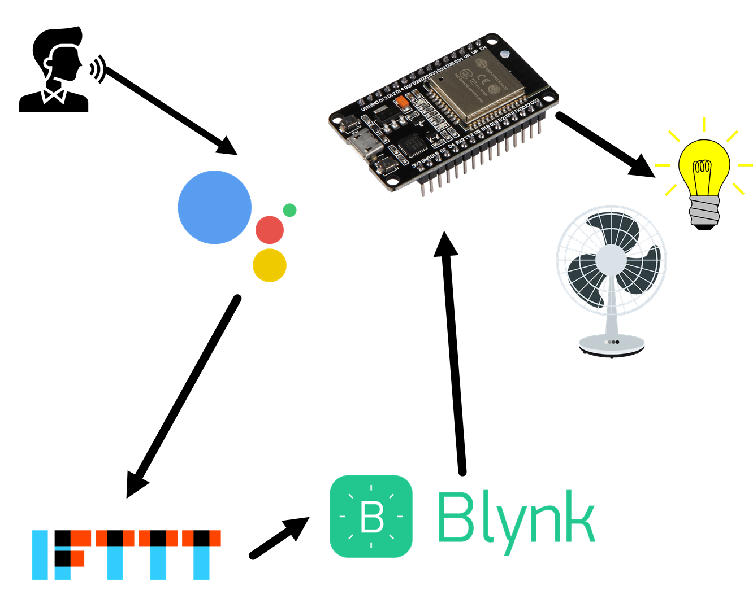
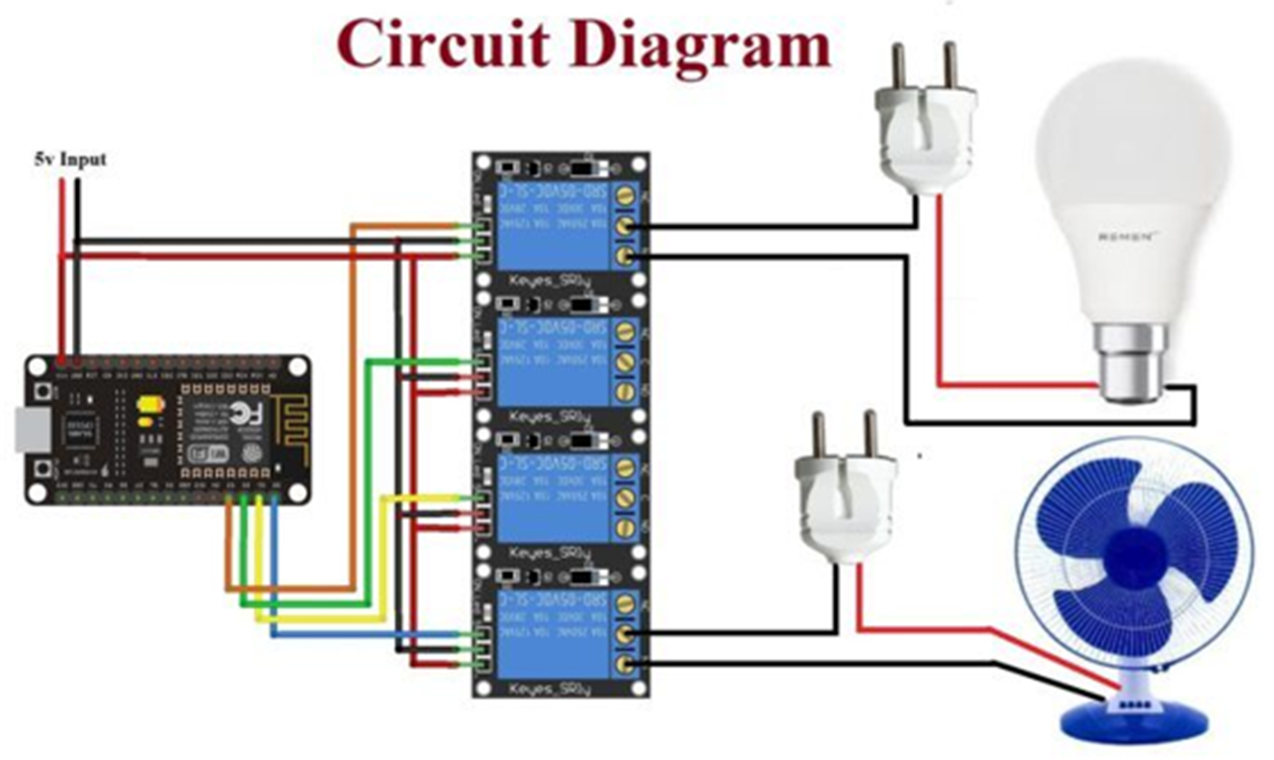
Komponen Utama
Google Assistant
IFFFT
Blynk
ESP32
Relay

Slide 3
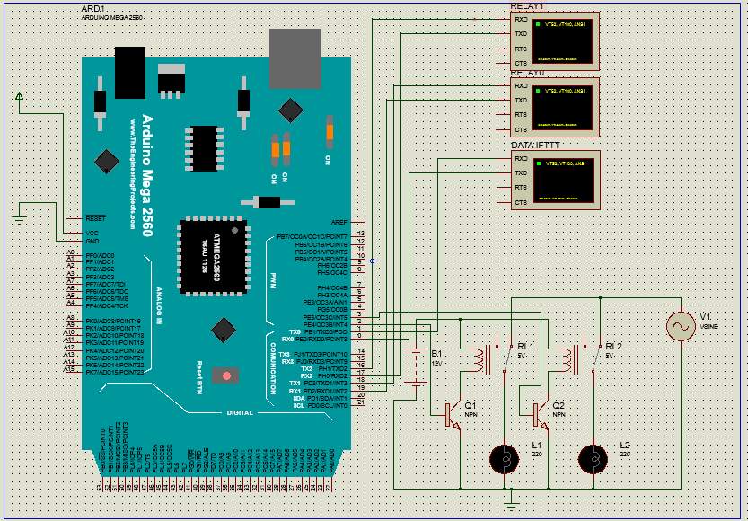
Simulasi Project

Slide 4
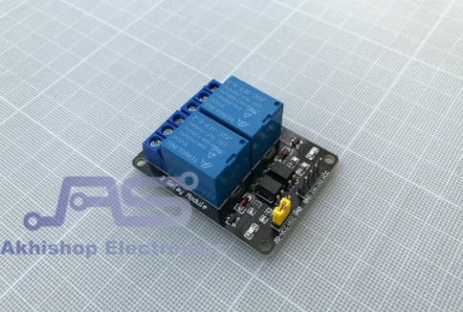
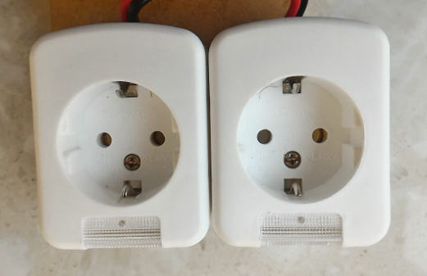
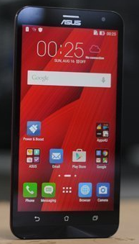

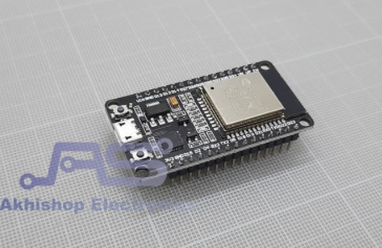
Prototype Alat

Slide 5
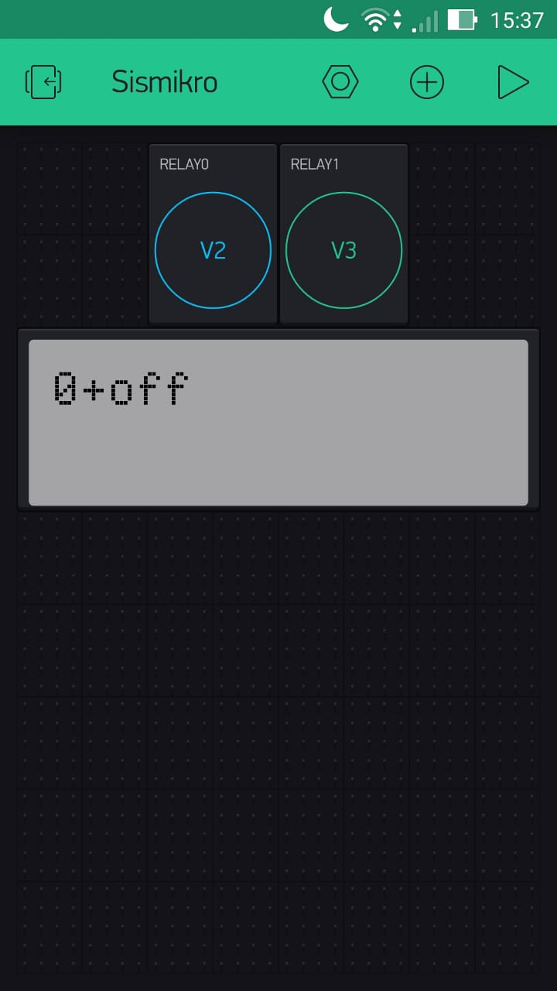
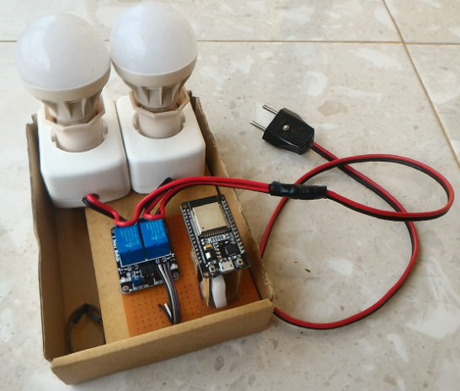
GUI Blynk
Data ESP32
Rancangan Alat
Data IFTTT

Slide 6
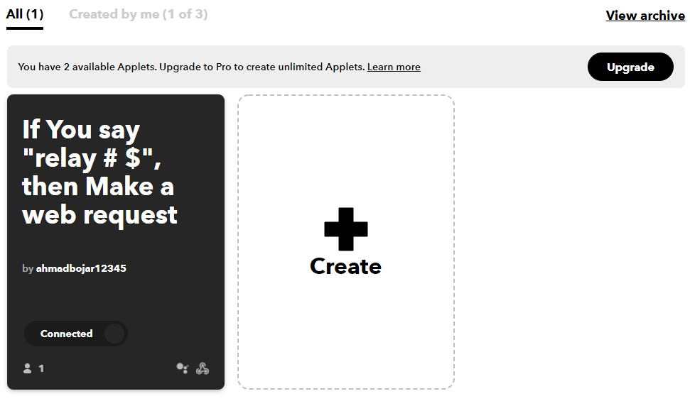
Pengaturan IFTTT
https://ifttt.com/

Slide 7

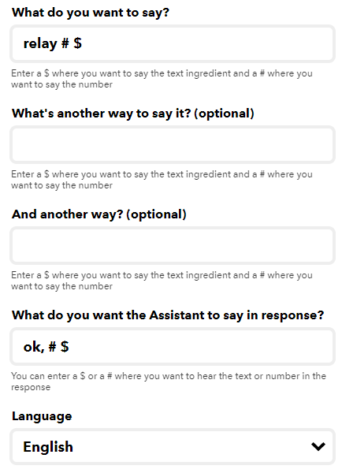

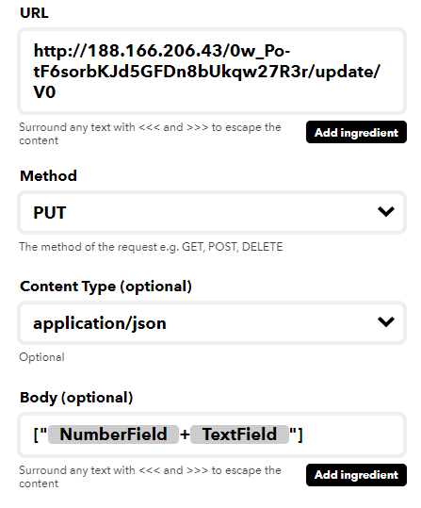
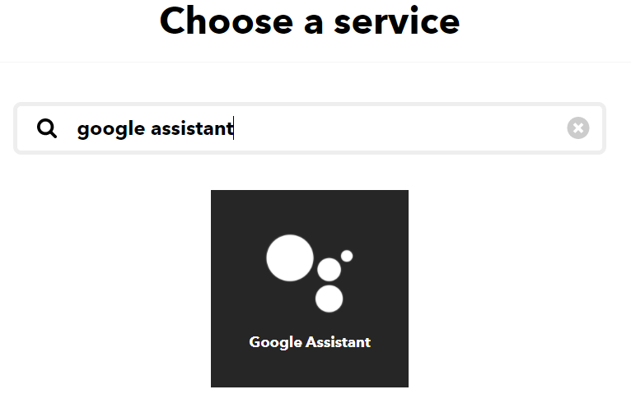

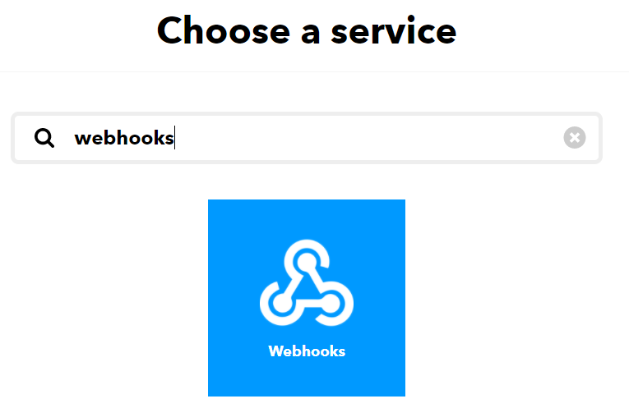
Google assistant
Webhooks

Slide 8
Program ESP32
#define BLYNK_PRINT Serial
#include <WiFi.h>
#include <WiFiClient.h>
#include <BlynkSimpleEsp32.h>
#include <SimpleTimer.h>
int relay0 = 2;
int relay1 = 4;
char auth[] = "0w_Po-tF6sorbKJd5GFDn8bUkqw27R3r";
char ssid[] = "ABojar";
char pass[] = "1234567890";
BLYNK_WRITE(V2) {
tombol0 = param.asInt();
if(tombol0==1){pin=0; kondisi="on";}
else{pin=0; kondisi="off";}
status_timer=1;
}
BLYNK_WRITE(V3) {
tombol1 = param.asInt();
if(tombol1==1){pin=1; kondisi="on";}
else{pin=1; kondisi="off";}
status_timer=1;
}
Library & Inisialisai
Data Blynk
Run WiFi, Blynk, Timer
WiFi.begin(ssid, pass);
Blynk.begin(auth, ssid, pass, "blynk-cloud.com",
8080);
timer.setInterval(100L,timer_data);
BLYNK_WRITE(V0){
data_str = param.asStr();
for(int i=0; i<data_str.length(); i++){
if(String(data_str[i])=="+") {status_ambil=1;pengurang=i+1;}
else if(status_ambil==0) {angka+=data_str[i];}
else if(status_ambil==1) {perintah+=data_str[i];}
}
status_ambil=0;
pin=angka.toInt();
kondisi=perintah;
angka = "";
perintah = "";
status_timer=1;
}
void timer_data(){
if(status_timer==1){
if(pin==0 && kondisi=="on")
{digitalWrite(relay0, LOW);Blynk.virtualWrite(V2, 1);}
else if(pin==0 && kondisi=="off")
{digitalWrite(relay0, HIGH);Blynk.virtualWrite(V2, 0);}
else if(pin==1 && kondisi=="on")
{digitalWrite(relay1, LOW);Blynk.virtualWrite(V3, 1);}
else if(pin==1 && kondisi=="off")
{digitalWrite(relay1, HIGH);Blynk.virtualWrite(V3, 0);}
}
status_timer=0;
}
Data IFTTT
Kontrol Relay

Slide 9
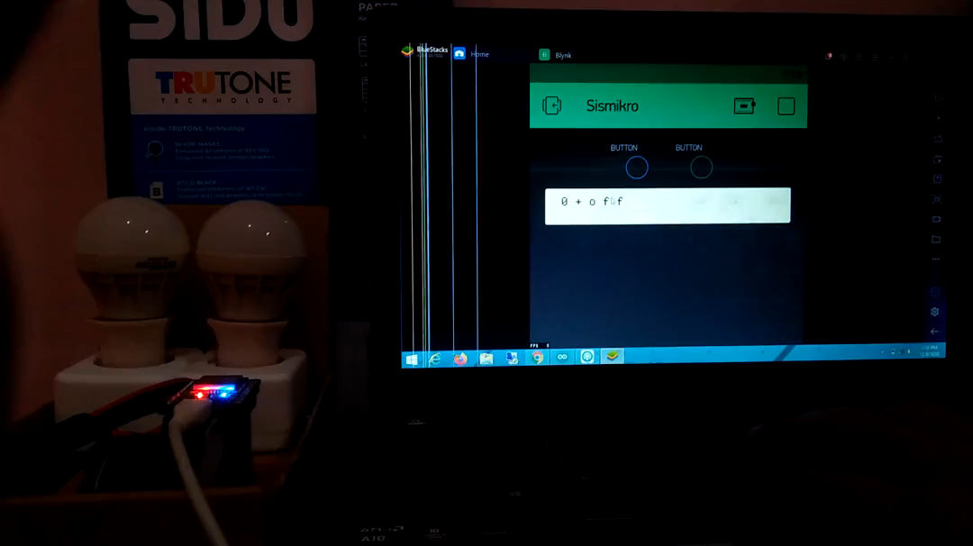
Video Demo 1

Slide 10
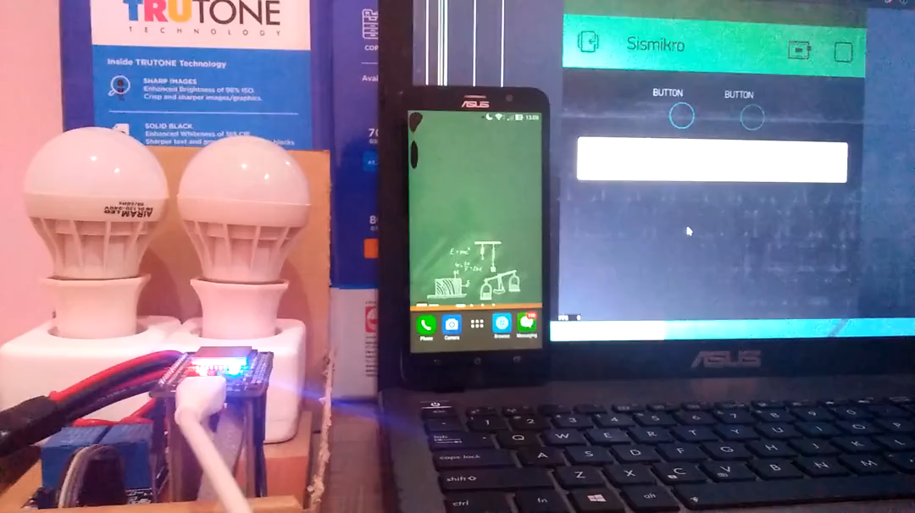
Video Demo 2

Slide 11
Terima Kasih

